Slide 1


Working with Texts and Files
Siddharth Singh

Slide 2
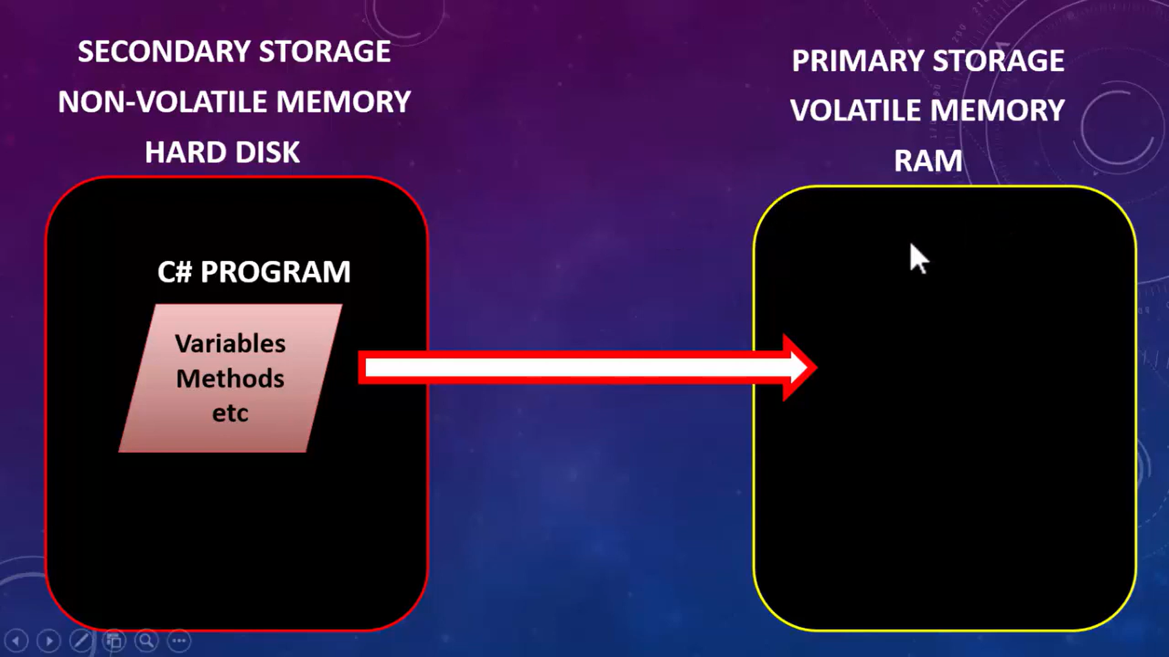
Working with Files

Slide 3

Working with Files

Slide 4


Slide 5
File Handling In C#
1. A file is a collection of data stored in a disk with specific name and a directory path.
2. Name => abc.txt
Directory path => C:\Program File\Siddharth\abc.txt.
3. For Example: notepad file txt, word file .docx, WordPad files .rft .
4. File handling allow to store/ retrieve data on permanent storage.
5.When a file is opened for reading or writing, it become a stream.
6. A stream is basically the sequence of bytes passing through communication path.
7. These are two main streams:
Input Stream – reading purpose Output Stream – writing purpose

Slide 6
8. C# provide the few basic of classes for creating, reading, and writing to file on the secondary storage.
9.They are located in the System.IO namespace and used both in desktop application and the web applications.
Classes used in file handling in C#
FileStream -> C# FileStream class provides a stream for file operation. It can be used to perform synchronous and asynchronous read and write operations.
BinaryReader -> BinaryReader class is used to read binary information from stream.
BinaryWriter-> BinaryWriter class is used to write binary information into stream
StreamReader -> StreamReader class is used to read string from the stream and also provide the readline and read method.

Slide 7
StreamWriter-> C# StreamWriter class is used to write characters to a stream in specific encoding
StringReader -> StringReader class is used to read data written by the StringWriter clas
StringWiter-> This class is used to write and deal with string data rather than files.
DirectoryInfo-> DirectoryInfo class is a part of System.IO namespace. It is used to create, delete and move directory. It provides methods to perform operations related to directory and subdirectory
FileInfo -> The FileInfo class is used to deal with file and its operations in C#. It provides properties and methods that are used to create, delete and read file. It uses StreamWriter class to write data to the file.

Slide 8
Working with Texts
1.In general, text is a collection of String or Word that are understandable by the reader
2. We can not directly deals with text but we can direct deals with text file in while working with file handling
3. With the help of String we can deals with text.
4. In C#, string is an object of System.String class that represent sequence of characters. String are immutable.
5. We can perform many operations on strings such as concatenation, comparision, getting substring, search, trim, replacement etc.
6. In C# we have string as a data type keywords and String as a class.
string s1 = "hello";//creating string using string keyword
String s2 = "welcome";//creating string using String class
We have various of method to deals with string but few of them are following

Slide 9
String Methods
Formatting
ToLower() //hello world
ToUpper() //HELLO WORLD
Trim() // remove all leading and trailing white-space characters from the current String object
Searching
IndexOf(‘a’)
LastIndexOf(“Hello”)
Substrings
Substring(startIndex)
Substring(startIndex,index)
Replacing
Replace(‘a’,’I’)
Replace(“Singh”,”Singham”)
Null Checking
String.IsNullOrEmpty(str)

Slide 10
String.IsNullOrWhiteSpace(str)
Splitting str.split(‘’)
Converting String to number int.Parse(str) or Convert.ToInt32(str)
Converting Number to String int 1=32; string s=i.ToString() or i.ToString(“C”) // C is format string represent as a currency
Format strings c or C –currency d or D- decimal x or X- hexadecimal f or F- Fixed Point

Slide 11
String Builder
1. Defined in System.Text
2. A mutable string
3. Easy and fast to create and manipulate strings
Not for Searching Indexof() LastIndexOf() Contains() StartsWith() And have many method string builder not support
String Manipulation Methods Append() Insert() Remove() Replace() Clear()

Slide 12

Thank You
2022.

